Slide 1
Classification and Regression

Slide 2
OVERVIEW
01
04
Common Classification Algorithms
What is Classification and Regression?
02
05
Use Cases
Common Regression Algorithms
03
06
Real-life Examples
Comparison

Slide 3
Machine Learning Classification
Supervised learning
Unsupervised learning
Reinforcement learning
Classification
Reduction
Fraud detection
Email spam detection
Diagnostics
Image classification
Text mining
Data visualization
Face detection
Voice detection
Finances
Manufacturing
Stock management
Autonomous cars
Regression
Regression
Risk assessment
Score prediction
City planning
Targeted marketing

Slide 4
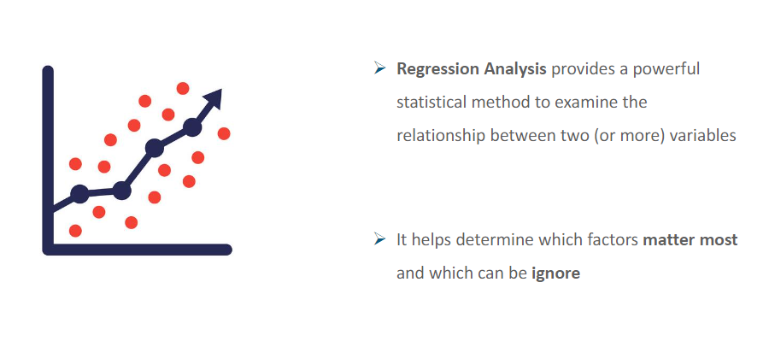
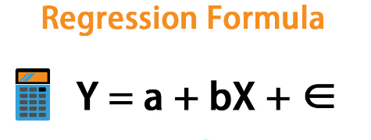
Why use Regression?

Slide 5
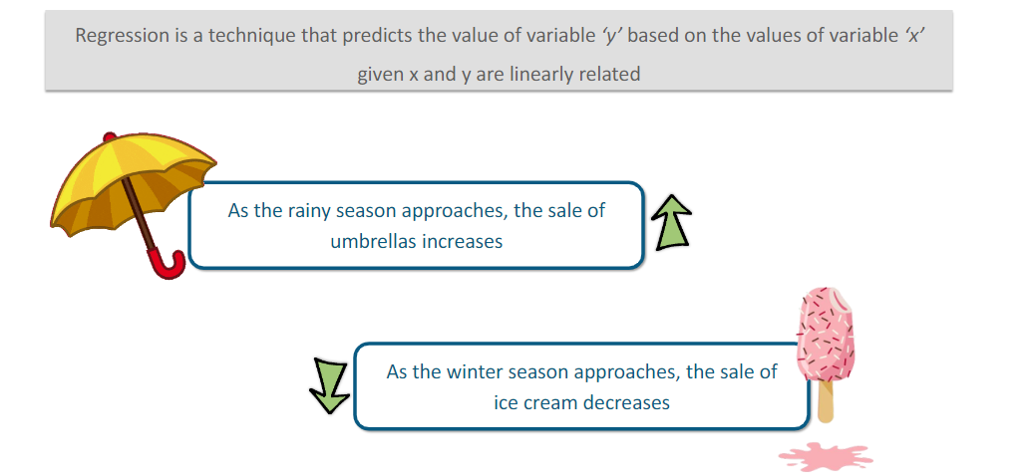
What is Regression?

Slide 6
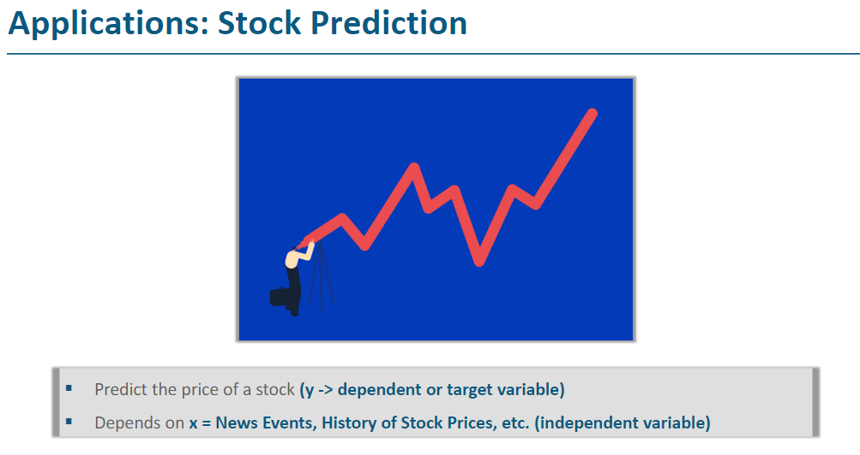
Use Cases FOR Regression

Slide 7
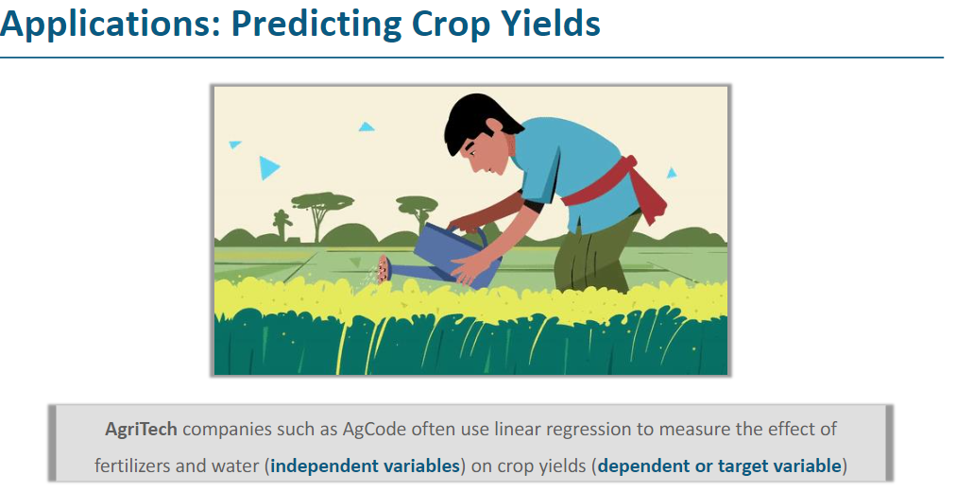
Use Cases FOR Regression

Slide 8
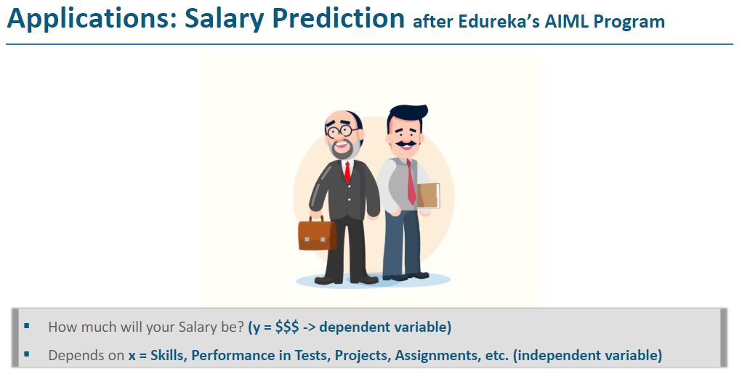
Use Cases FOR Regression

Slide 9
Regression Algorithms
Linear Regression
01
Polynomial Regression, Ridge and Lasso
Decision Tree And Random Forest Regression
02
03
Support Vector Regression
04
Gradient Boosting Regression
05
Neural Network Regression

Slide 10
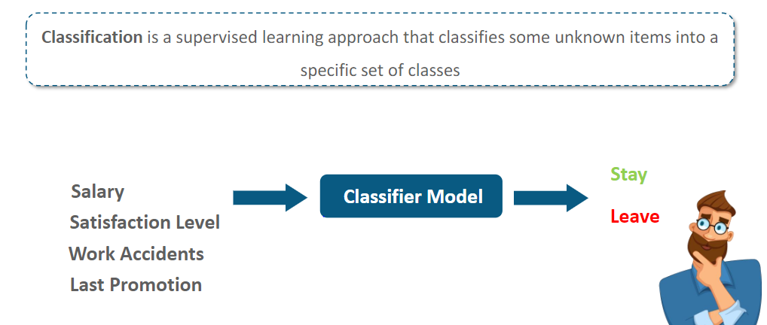
What is Classification?

Slide 11
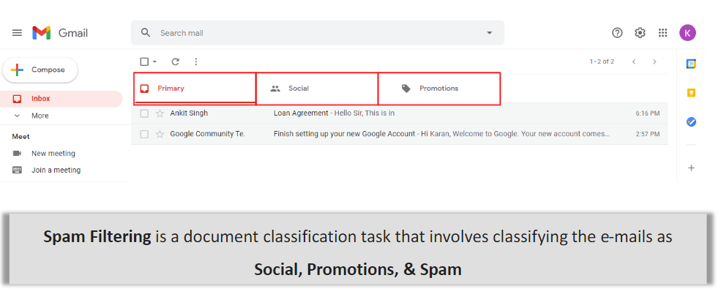
Use Cases FOR Classification

Slide 12
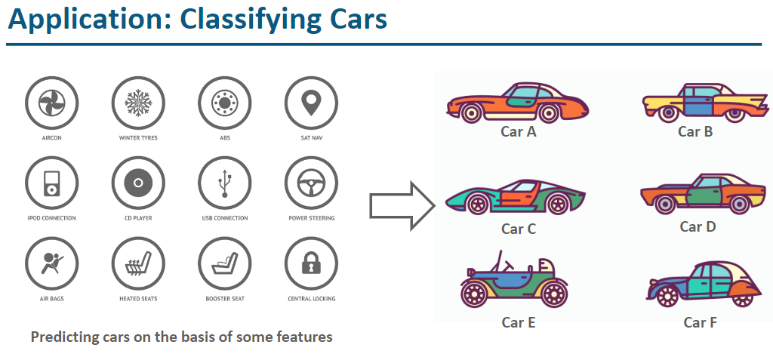
Use Cases FOR Classification

Slide 13
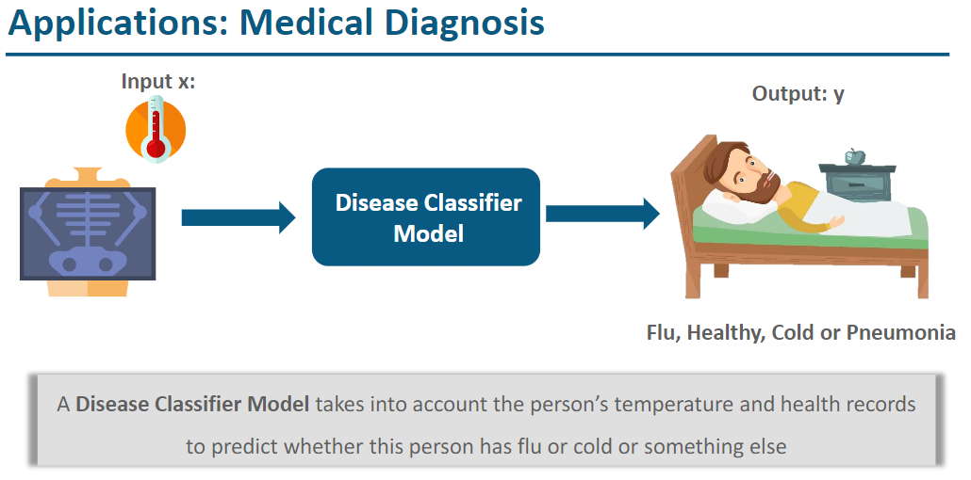
Use Cases FOR Classification

Slide 14
Classification Algorithms
01
Logistic Regression
Decision Tree And Random Forest classifier
02
03
Support Vector Machines (SVM)
k-Nearest Neighbors (kNN)
04
Gradient Boosting
(e.g., XGBoost, LightGBM)
05
Neural Networks
(Deep Learning)

Slide 15
Machine learning advantages vs disadvantages
Classification
Regression
Objective: Predict categorical outcomes, assigning data points to predefined classes.
Output: Discrete labels or classes.
Use Cases: Spam detection, sentiment analysis, disease diagnosis.
When to Use: For problems with distinct categories or classes, where the goal is to classify input into one or more predefined groups.
Objective: Predict continuous outcomes, estimating values within a range.
Output: Continuous numeric values.
Use Cases: Stock price prediction, house price prediction, temperature forecasting.
When to Use: For problems involving the prediction of a continuous quantity, where the goal is to estimate a value within a specific range.

